Slide 1

Analysis of Economic and Social Factors on Life Expectancy
UNC Data Analytics Boot Camp – Project 1
Team members:
Ashok Singh, Christopher Glessner, Gilberto Ramirez, Michael Cary

Slide 2

Background
Economic factors
Per capita GDP
Healthcare spending
Urbanization
Social factors
Education
Violence
Notes:
Previous studies highlighted the effect of different variables such as gross domestic production (GDP) per capita, healthcare expenditure, and urbanization rate on life expectancy (2–8).
Although these models exist, consideration of determinants of health generally includes: economic circumstances, social factors (individual and community behaviors), and environmental factors. Our analysis does not intend to be a comprehensive look at all factors that could be considered determinants. It aims instead to gather data we do have about some of the better-understood factors that may influence health. These data are limited, and won’t allow us to pinpoint, for instance, the effect of income on diabetes outcomes. Rather, these data which are aggregated to the country level can give us a global sense of which factors might negatively influence health outcomes or lead to higher spending relative to similarly sized and wealthy countries.
Life expectancy
Life expectancy at birth (LEB) is defined as the average number of years one would be expected to live at birth.
Life expectancy is commonly used as one of the main indicators to assess health status of a population in developed as well as developing countries, and it is also closely associated with the degree of economic and social development of a country or a region (1–3).

Slide 3
Project Aim
To better understand which economic and social factors that affect life expectancy around the world?
>>
Notes:
How economic and social factors affect life expectancy around the world?
Economic factors – GDP per capita, healthcare spending and urbanization
Social factors – education and violence

Slide 4

Data Source and Variables
Data Source
Using 2005, 2010, and 2015 data from the United Nations
(UN.data.org)
Variables
Economic factors (GDP per capita, healthcare spending, urbanization [% urban population),
Social factors (education [enrollment in college, tertiary education] and violence [homicide and assault per 100,000]),
Life expectancy (average number of years one would be expected to live at birth).
Notes:
The data come from the UN’s online database (http://un.data.org/), a large-scale international dataset and that is freely available to the public. The data cover 226 countries and regions of the world, with observations in 2005 to 2015. The data on economic, social, and environmental factors as well as health was obtained from the UN Data.org. These variables were chosen based on a very brief literature review and their availability.
Life expectancy at birth is defined as: the average number of years one would be expected to live at birth. Life expectancy is commonly used as one of the main indicators to assess health status of a population, and it is also closely associated with the degree of economic and social development of a country.

Slide 5
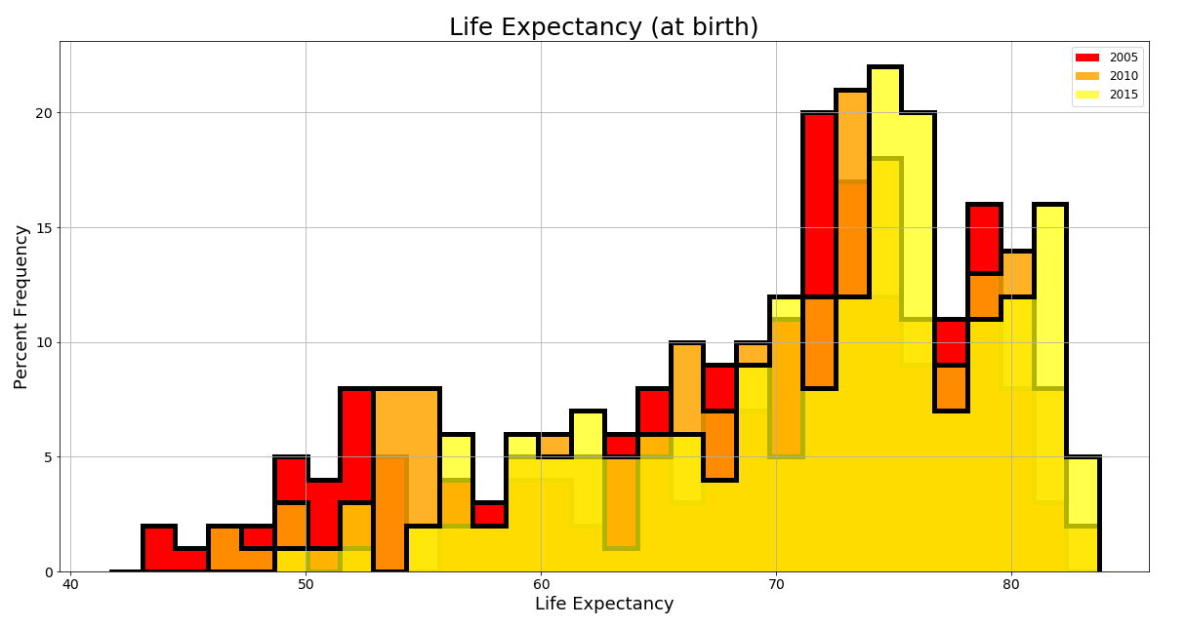
Life Expectancy Across Years
Notes:
Interpretation:
This figure shows global life expectancy is increases over overtime, from 2005 to 2015
Note:
Life expectancy at birth indicates the number of years a newborn infant would live if prevailing patterns of mortality at the time of its birth were to stay the same throughout its life.

Slide 6
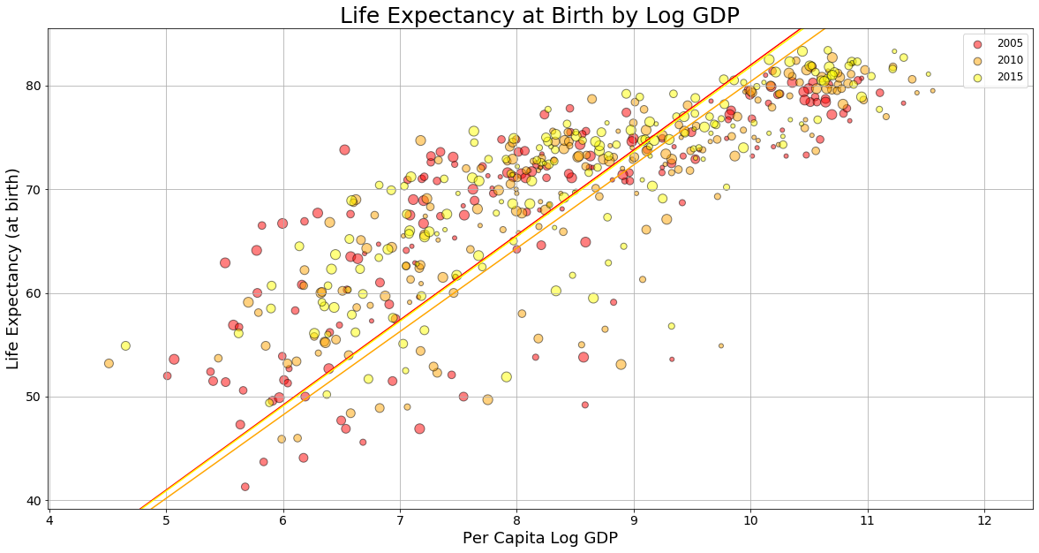
Life Expectancy vs. Per Capita GDP
Notes:
Interpretation:
The figure shows a positive correlation between the two variables which is supported by this positive slope. In other words, life expectancy increases with respect to GDP per capita (PPP). If we look at the time trend for each country, we notice that the majority of countries follow an upward trajectory—the population lives increasingly long lives as GDP per capita (PPP) increases.
Note:
Per capita GDP is a measure of a country's economic output – it divides the country's gross domestic product by its total population. It’s a good measure of a country's standard of living or how prosperous a country feels to each of its citizens.

Slide 7
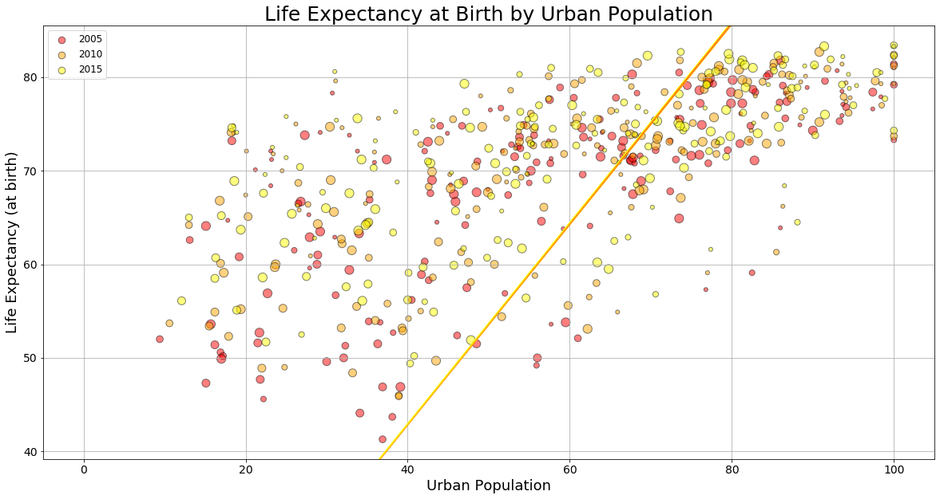
Life Expectancy vs. Urbanization
Notes:
Interpretation:
The figure seems to show a positive correlation between the two variables (which is supported by this positive slope). In other words, life expectancy increases over time with respect to the growing number of the population residing in urban areas.
Note:
Where is the greatest % of urbanization taking place? India, China?
Share of total population living in urban areas, 2005 to 2015
Urban population (% of total population) on y-axis and life expectancy on x-axis
Top 5 largest countries by population include
China
India
US
Indonesia
Brazil

Slide 8
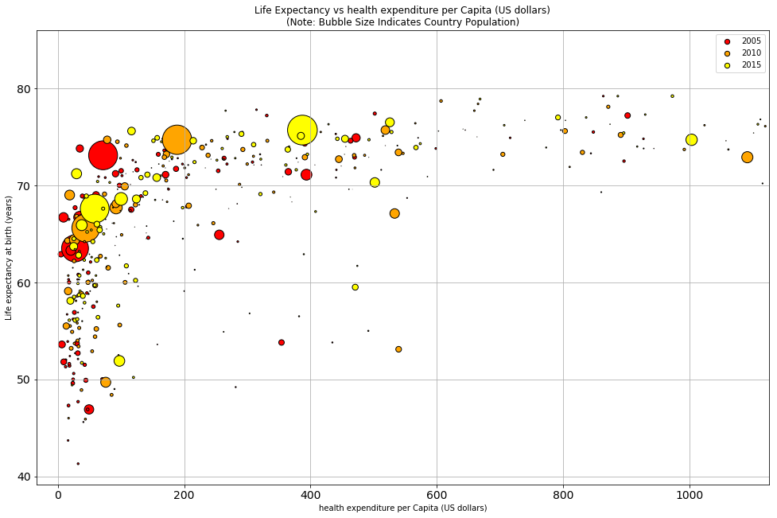
Life Expectancy vs. Health Expenditure
Notes:
Interpretation:
The figure above shows the relationship between life expectancy and what a country spends on health per person. If we look at the time trend for each country, note the majority of countries follow an upward trajectory up until $200 dollars and then it begins to level off —the population lives increasingly long lives as health expenditure increases up to $200 after which no additional benefit is experienced with additional spending.
Note:
Two data frames were merged to calculate health care spending
Health expenditure per capita is measured in US dollars
Which one is the US? I bet the US sticks out like a sore thumb. We know the US spends far more on health than any other country, yet the life expectancy of the US population is not longer relative to other countries that spend far less.

Slide 9
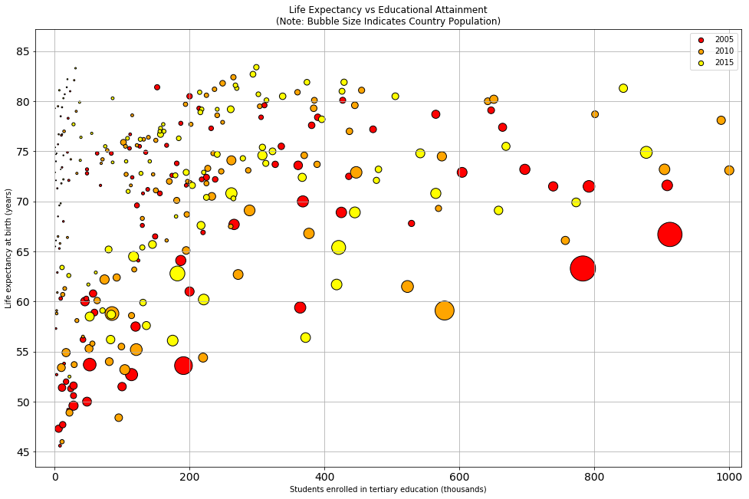
Life Expectancy vs. Education
Notes:
Interpretation:
The figure shows life expectancy increases with respect to the number of students enrolled in tertiary education increases. In other words, the population lives increasingly long lives as more people enroll in college (attain a college education) increases.
Note:
Tertiary education, more commonly referred to as postsecondary education, refers to academic pursuit undertaken after high school.
Educational attainment appears to be very important in increasing longevity for adults. However, despite the potential of education, it may be overly simplistic to assume that future investments in the education alone will increase life expectancy.

Slide 10
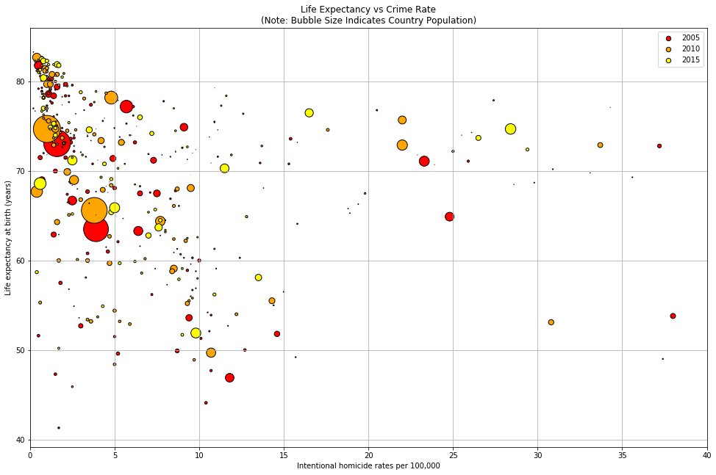
Life Expectancy vs. Homicide
Notes:
Interpretation:
As expected, because homicide has a direct impact on life expectancy, the figure shows that life expectancy decreases as the number of homicides increase.
Note:
In 2015 an estimated 470, 000 people worldwide were victims of homicide (global rate of 6.4 per 100 000).
Rates in high-income countries/areas are generally lower than rates in low- and middle-income countries/areas.
The vast majority of homicides occur in males and the highest rates are in males aged 15–29 years.
Estimates are not calculated for countries with populations under 90 000 in 2015.

Slide 11
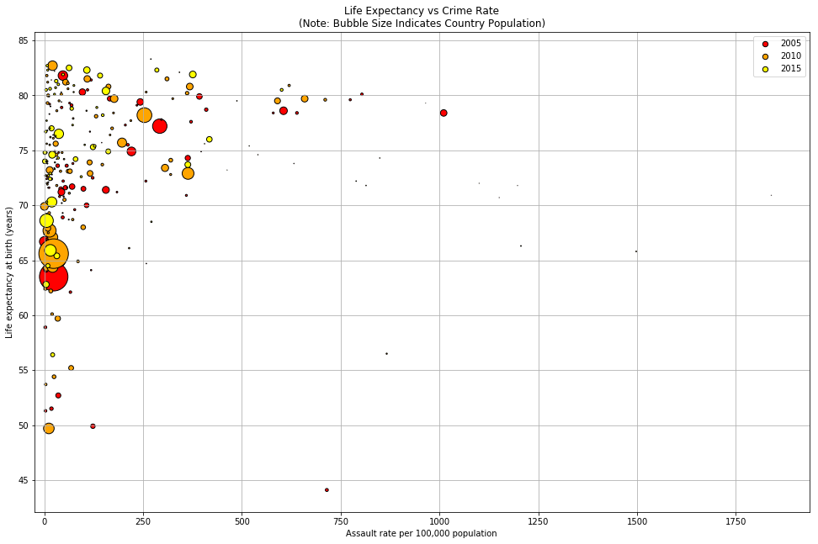
Life Expectancy vs. Assault
Notes:
Interpretation:
Note:

Slide 12
Next steps
Using a multiple regression model, we plan to determine the best correlation of life expectancy
More robust analysis of top 3 countries
Consider other factors including environment, i.e., type of energy use
Notes:
Although life expectancy has increased at the global level in the last decades and increased quantity varies among countries, there is a high disparity between developed and developing countries.
Ideas for next steps:
Determine which 5 countries have the highest GDP
Determine which 5 countries have the highest Life expectancy
Determine the relationship between GDP and Life expectancy

